Slide 1
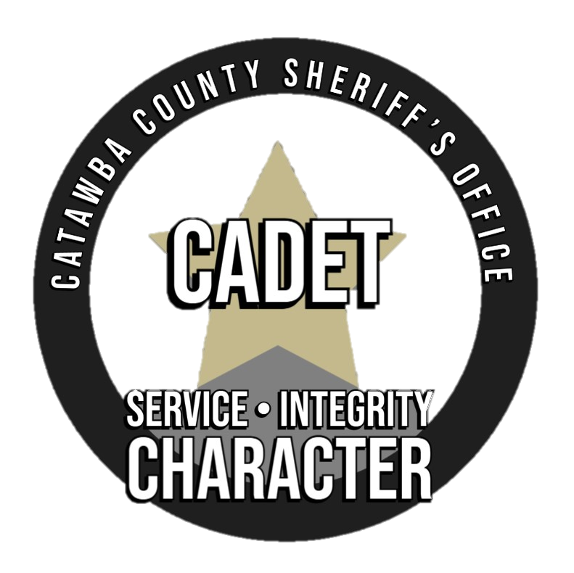
CATAWBA COUNTY SHERIFF’S OFFICE CADET PROGRAM
Training + Discipline+
Hard work= Success

Slide 2
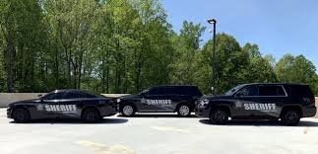
What is the Cadet Program?
It is a career-education program designed for young men and women ages 14 through 20 years old, it provides knowledge and training for those interested in a career in law enforcement
Participants will receive hands on and classroom experience to better prepare themselves for a career in law enforcement
OUR BEST TODAY FOR A BETTER TOMORROW!

Slide 3
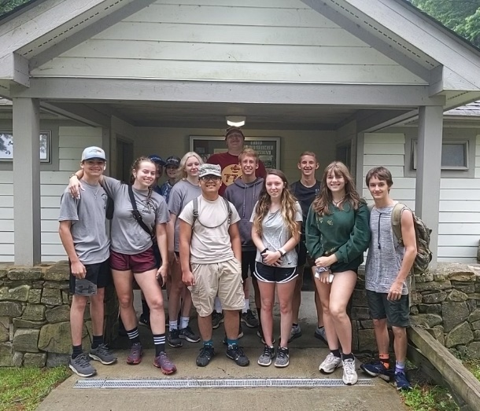
OUR MISSION
THE FOUR MAIN GOALS:
PURPOSE
Gain practical experience in their career of interest.
Engage in program activities centered on the 5 emphasis areas (career opportunities, life skills, citizenship, character and leadership building)
Experience positive leadership from adult and youth leaders and have the opportunity to take on leadership roles
Have a chance to learn and grow in a supportive, caring and fun environment
The Cadet Program purpose is to provide experiences to help young people mature and prepare them to become responsible caring adults
Cadets are ready to investigate the meaning of interdependence in their personal relationships and communities

Slide 4
PROGRAM METHODS
Voluntary Association: In a voluntary association between youth and adults, youth are receptive to new ideas and experiences, a connection to new ways of thinking and acting.
Ethical Decision Making: By taking responsibility for their programs, activities and experiences; Cadets learn how to make decisions and handle ethical dilemmas.
Group Activity: Cadet activities are interdependent group experiences in which success is dependent on the cooperation of all (TEAMWORK).
Recognition of Achievement: Recognition comes through formal awards and acknowledgment of a youth’s competence and ability by peers and adults.
Democratic Process: The election of Cadet officers is important to the success of the program.
Experiential Learning: Is about curiosity, exploration, and adventure. Learning by doing provides opportunities for developing new skills and participating in action-oriented activities.

Slide 5
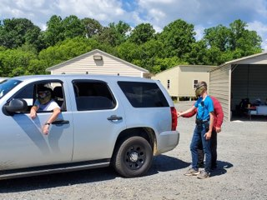
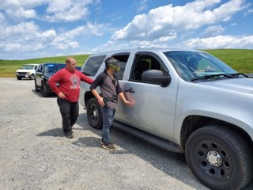
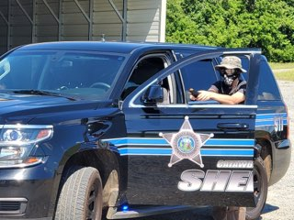
LESSONS AND ACTIVITIES
Physical Fitness Assessment
Communication Skills
Radio Procedures
Report Writing
Patrol Techniques (Classroom and Practical)
Traffic Stops (Classroom and Practical)
Rapid Deployment (Classroom and Practical)
Laser Shot
Domestic Violence
Scenario-Based Training
POPAT (Police Officer Physical Agility Test)

Slide 6
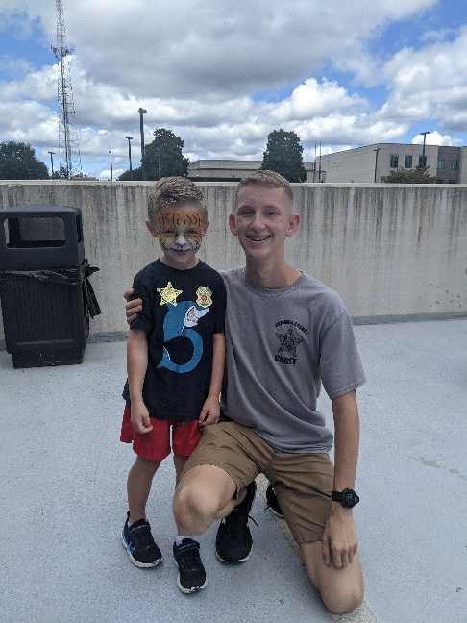
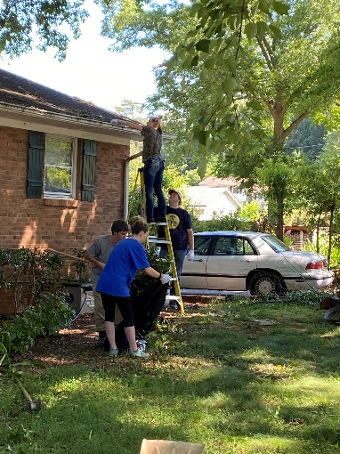
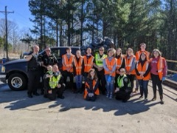
CADETS
The Cadet program is designed to help youth learn by doing. Training includes not only classroom instruction, but also hands-on practical exercises. Studies show this to be the most effective way to learn the skills needed in the Law Enforcement field.
Cadets learn how to be effective leaders, how to make ethical decisions , and how to communicate with others.
Cadets also participate in their community through service projects and special events.

Slide 7
APPLICATIONS AND FORMS AVAILABLE AT… https://www.catawbacountync.gov/county-services/sheriffs-office/programs/cadet-program/

